Slide 1
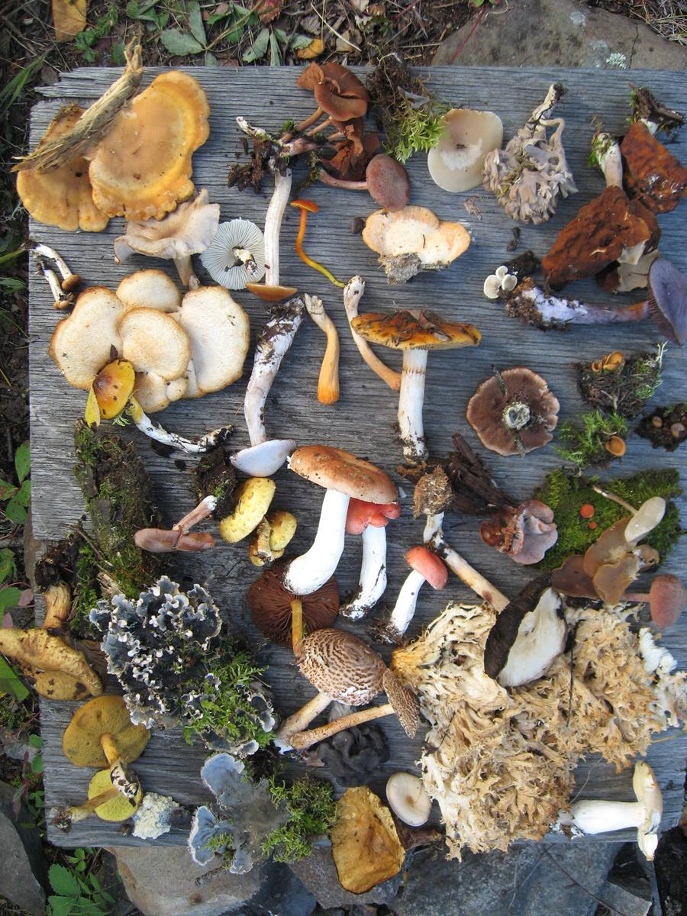
Biodiversity
Endangered species data analysis

Slide 2
Table of Contents
Species_info.csv file
Species_info.csv file(Contd.)
Endangered Species
Chi Squared Test
Foot and Mouth disease study
Sample size determination
Sample size determination(Contd.)
Biodiversity

Slide 3
Species_info.csv file
Species_info.csv file contains data about different species in our National Parks and includes the following:
The scientific name of each species
The common names of each species
The species conservation status
There are 7 categories of species and these are:
Amphibian
Bird
Fish
Mammal
Nonvascular Plant
Reptile
Vascular
Extract from species_info.csv file

Slide 4
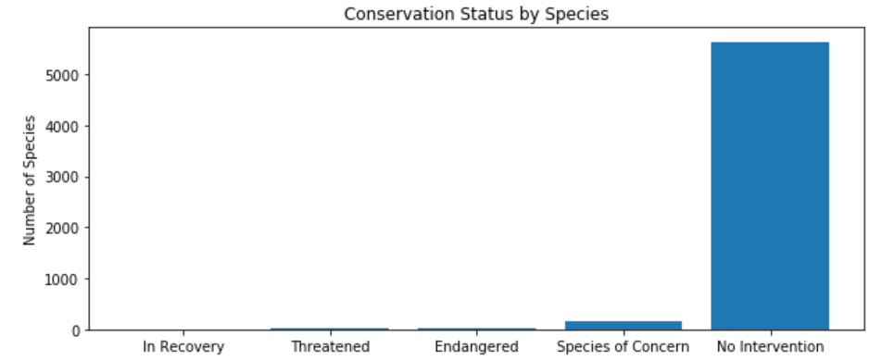
Species_info.csv file(Contd.)
Table 1.
The conservation status values for each species can be:
Endangered
In Recovery
Species of Concern
Threatened
No Invention(we have replaced none or blank in the file, which is where no protection is required, with ‘No Intervention’)
Sorting the data by conservation status and scientific name we can determine how many species require no protection and how many will require some level of protection – please see the Table and Bar Chart to the right of the page.
You will see from the table/graph that 97% of all species require no protection. There are approximately 2.8% of species that are in serious risk of extinction.
 | conservation_status | scientific_name
 | In Recovery | 4
 | Threatened | 10
 | Endangered | 16
 | Species of Concern | 161
 | No Invention | 5633
Chart 1.

Slide 5
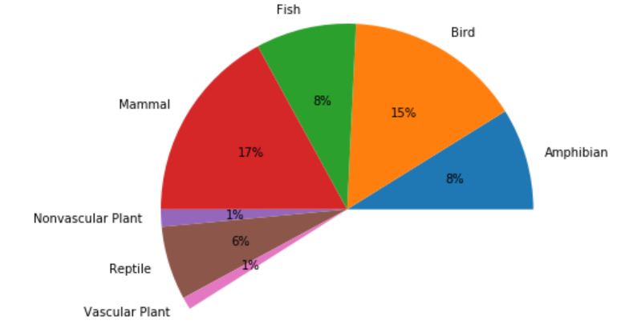
Endangered Species
Table 2.
Are certain types of species more likely to be endangered?
To try to answer this question we have pivoted the data by category and by whether the species are protected or not protected. We have also calculated the percentage of each species that are protected - the number of species that are protected divided by the species protected + species not protected(the total number of species).
The results are shown in Table 2 and it looks like species in the Mammal category are more likely to be endangered than species in Bird category which has the second highest percent of species that are protected. To determine whether this statement is correct we will conduct a chi squared test.
Category | not protected | protected | percent protected
Amphibian | 72 | 7 | 0.088608
Bird | 413 | 75 | 0.153689
Fish | 115 | 11 | 0.087302
Mammal | 146 | 30 | 0.170455
Nonvascular Plant | 328 | 5 | 0.015015
Reptile | 73 | 5 | 0.064103
Vascular Plant | 4216 | 46 | 0.010793

Slide 6
Chi Squared Test
Firstly we need to create a Contingency table before we run the Chi square test.
Our null hypothesis is that species in category Mammals are more likely to be endangered than species in category Bird.
Running our Chi Square test returns a pval=0.6875
A pval <0.05 means there is a significant difference between the 2 categories and we can accept the null hypothesis but in this case we reject the null hypothesis the difference is not significant.
Lets see if there is a significant difference between Reptile and Mammal. Running our Chi Square test returns a pval=0.038.
In this case there is a significant difference between Reptile and Mammal. So we expect species in category Mammals to be more likely to be endangered than species in category Reptile.
Is there a significant difference between Mammal and Fish? Running our Chi Squared test again returns a pval = 0.056 so in this case the answer is yes.
Our significance calculations show that species in the Mammal category are more likely to be endangered than species in other categories.
Contingency Table 1
 | protected | not protected
Mammal | 30 | 146
Bird | 75 | 413
Contingency Table 2
 | protected | not protected
Mammal | 30 | 146
Reptile | 73 | 5
Contingency Table 3
 | protected | not protected
Mammal | 30 | 146
Fish | 11 | 115

Slide 7
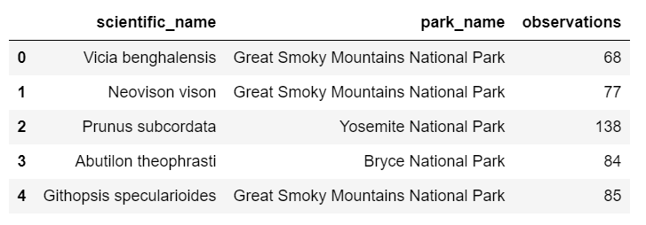
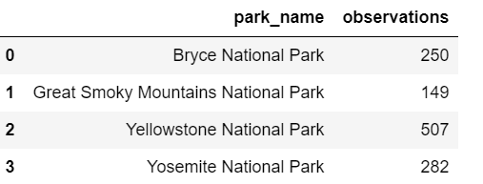
Foot and Mouth disease study
Extract from observations.csv file
Conservationists have been recording sightings of different species at several national parks for the past 7 days.
An extract from the data file is shown on the left.
Scientists have been studying foot and mouth disease in sheep and know that 15% of these sheep are carrying the disease at Bryce National Park. Park rangers at Yellowstone National Park have been running a program to reduce the rate of foot and mouth disease at the park. They want to
Test whether the program is working or not
be able to detect reductions of at least 5 percentage points
know the number of sheep that they would need to observe for Bryce National Park and Yellowstone National Park
know how many weeks you would need to observe these sheep in order to observe enough sheep for each park
Before we can determine an appropriate sheep sample size we need to extract Mammals that are sheep from the species_info.csv file and together with the observations.csv file we can then determine the total number of sheep in each park. The results can be seen in table 3.
Table 3.

Slide 8
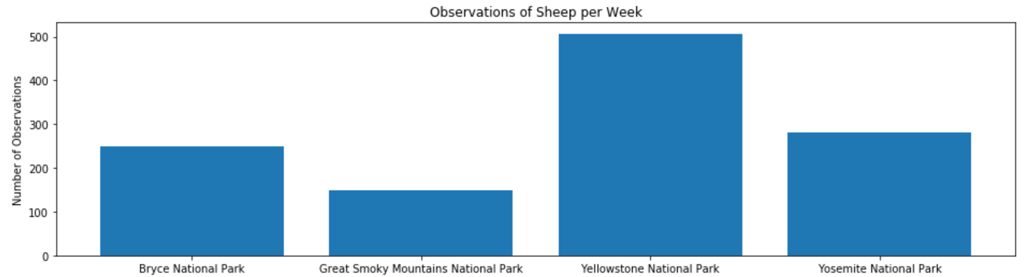
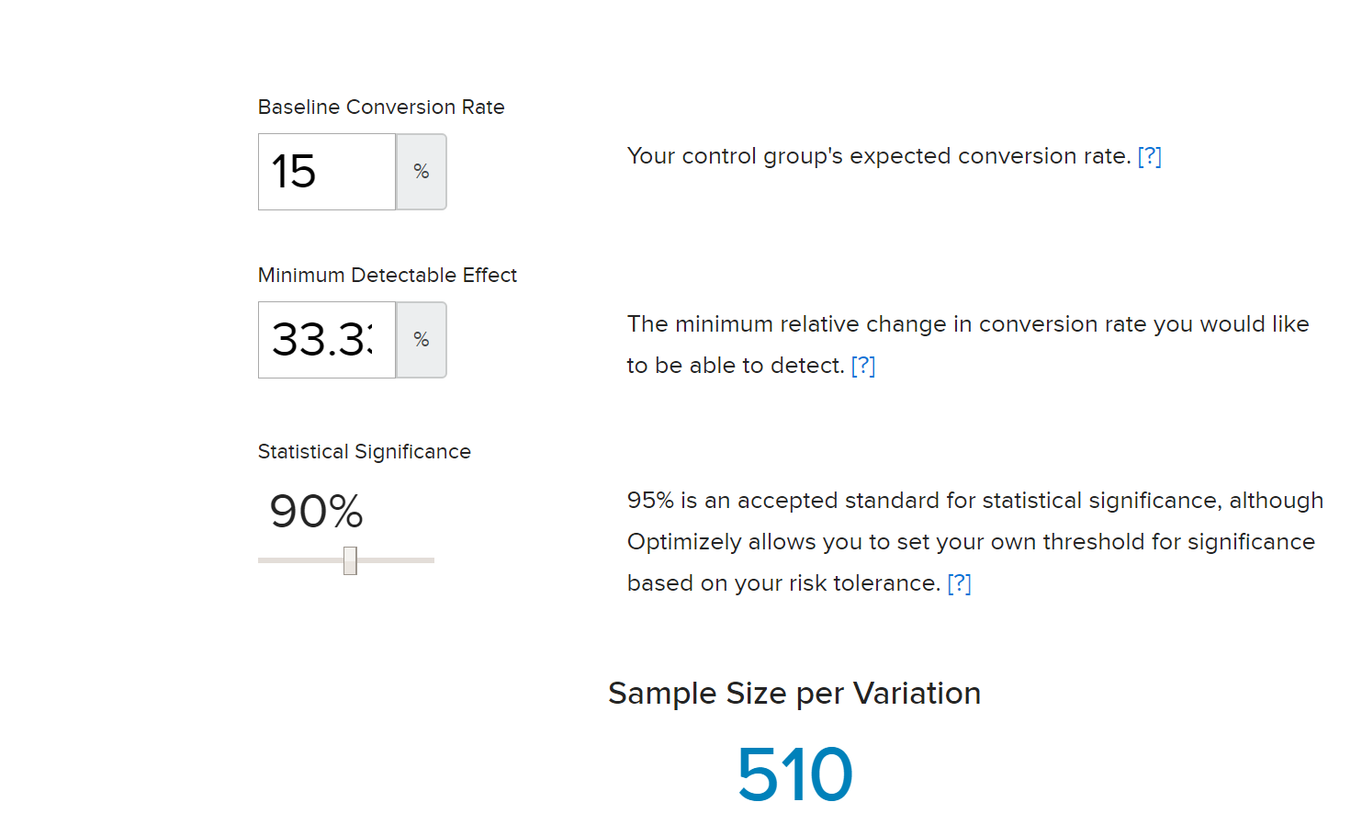
Sample size determination
The same data is depicted in chart 2 and shows the different number of sheep observations per week at each park.
As stated previously we know that 15% of the sheep at Bryce National Park have foot and mouth disease.
So our Baseline Conversion Rate = 15%
Park rangers at Yellowstone National Park are running a program to reduce the rate of foot and mouth disease at the park and want to be able to detect reductions of at least 5 percentage points. The Minimum Detectable Effect(MDE) which is the smallest relative change in the conversion rate you are interested in detecting is calculated as follows:
MDE=100*reductions detected/Baseline Conversion Rate
= 100*0.05/0.15 = 33.33%
We will use a 90% Statistical Significance so we are accepting a 10% false positive rate, where the result is not real(100%-10%=90%)
So we can now input the baseline conversion rate, MDE and the 90% statistical significance into our sample size calculator to derive the number of sheep that would need to be observed from each park. We are 90% confident that 510 sheep will need to be observed to be able to detect reductions
Chart 2.
Sample Size Calculator

Slide 9
Sample size determination(Contd.)
of at least 5 percentage points. How many weeks would you need to observe sheep at Bryce National Park in order to observe enough sheep? How many weeks would you need to observe at Yellowstone National Park to observe enough sheep?
We know that the current observation of sheep per week for Bryce National Park and Yellowstone National Park are 250 and 507 respectively.
The number of weeks you would need to observe enough sheep at both these parks is
No of weeks(Bryce) = 510/250 ~2 weeks
No of weeks(Yellowstone) = 510/507 ~ 1 week

